Slide 1
Food is Our Medicine
Welcome to the Learning Journey.

Slide 2
Agenda
What is FIOM?
Virtual Learning Circles
Resources
Learning Journey Overview
Introduction
Fall
Winter
Spring
Summer
Congratulations!
Notes:
RetroBoard - https://easyretro.io/publicboard/PZpUdQ57sKTYIrCVZkHU8jOYe363/9610f04a-efde-4553-83f6-6363c485a62a

Slide 3
Food is Our Medicine (FIOM) Action Learning Series
Build the understanding and narrative that Food is our Medicine
Provide health care leaders with knowledge and tools to decolonize food in health care
Inspire action, engagement and responsibility around Indigenous Foodways in health care settings

Slide 4
Who Should Participate?
Health care professionals interested in learning more about Indigenous perspectives, worldviews, and foodways and who are committed to advancing reconciliation in your organizations:
physicians
nurses
administrators
food service teams
social workers
dietitians
policy and program professionals

Slide 5
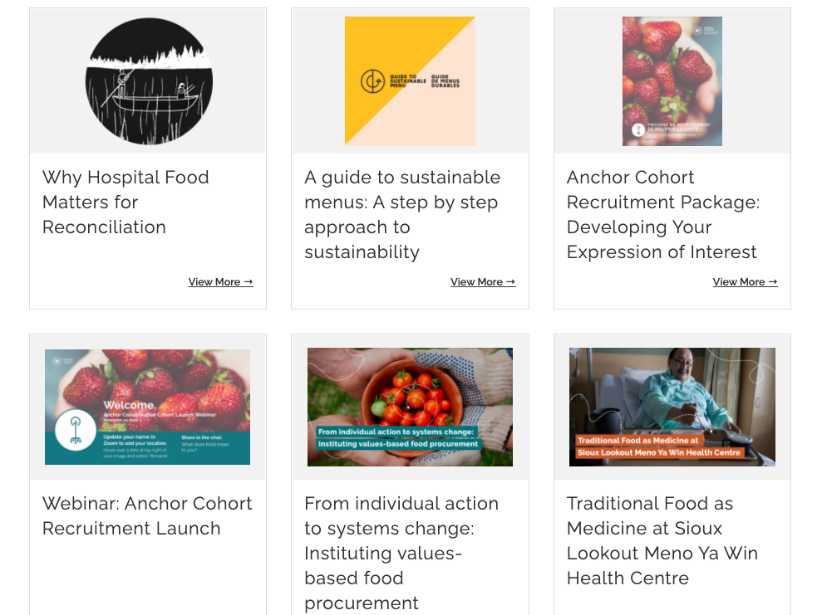
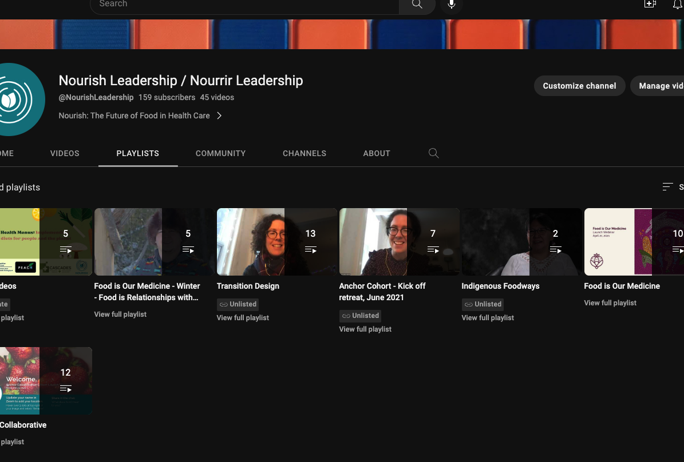
Resources
Nourish Website
Indigenous Foodways Digital Library
Nourish
YouTube Channel
Notes:
Nourish Website
Indigenous Foodways Digital Library
https://www.nourishleadership.ca/resources-1?tag=digital%20resource%20bundle
Nourish
YouTube Channel
https://www.youtube.com/playlist?list=PLbW2N6yLdjKP6zrUOwVEO06UKOlCFOlHh

Slide 6
Downloadable tools
We recommend meeting for (30 minutes - 1 hour) before each Virtual Learning Circle to reflect and share together on topics that are arising for you
Download the tools from our website to support you and your team as you work through the Learning Journey
Group work slidedeck (this slide deck!)
Posters for your office (see images on next slide)
Social media shares (next slide)
PDF modules for each season of the Learning Journey

Slide 7
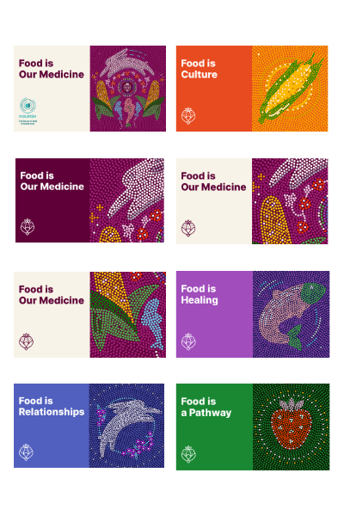
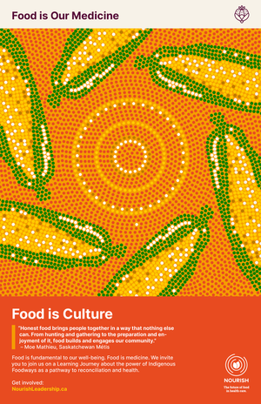
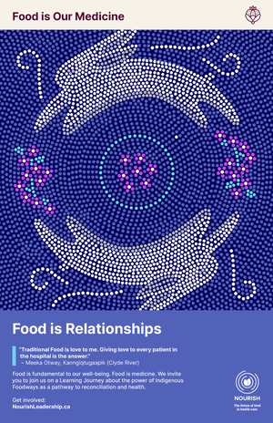
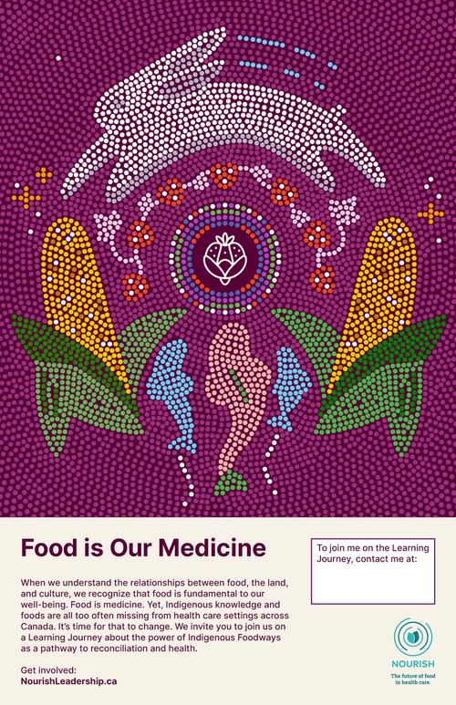
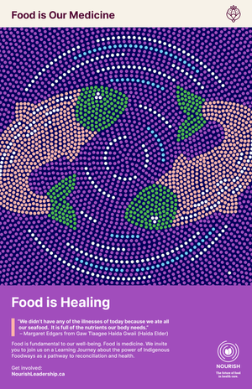
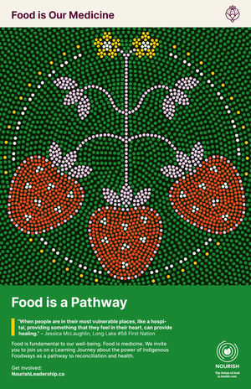
Feel free to print posters and download graphics to share your progress on social media!
Notes:
https://www.nourishleadership.ca/fiom-social

Slide 8
An Overview of the Learning Journey
Food is Our Medicine is a five-part, fifteen hour, self paced virtual Learning Journey, which you can think of as follows:
• The Introduction, Fall and Winter focus on the WHO and WHY
• Spring focuses on the WHAT
• Summer focuses on the HOW
The trajectory of this journey mimics the four seasons, which are so intricately linked to foodways. Within each season (module) are several key teachings. Here is an overview of the content within each season:
Fall: Seeing the Path (4 teachings) • Introducing two-eyed seeing and systems thinking • Situating yourself and the work on the land • Looking at the impacts of colonization on the health care experiences and foodways of Indigenous peoples in Canada
Winter: Ways of Relating (4 teachings) • Recognizing the relational aspects of foods and foodways • Moving toward reconciliation in health care • Understanding and supporting cultural mindfulness in health care
Spring: Coming to Know (4 teachings) • Showing examples of traditional food guides, stories, and teachings • Exploring and celebrating the diversity of Indigenous foodways • Highlighting the essentiality of self determination, and offering examples of community driven responses to COVID-19
Summer: Ways of Doing (4 teachings) • Discussing current barriers to Indigenous foods in health care • Highlighting existing traditional food programs in health care settings and examples of policies and tools • Offering options for next steps

Slide 9
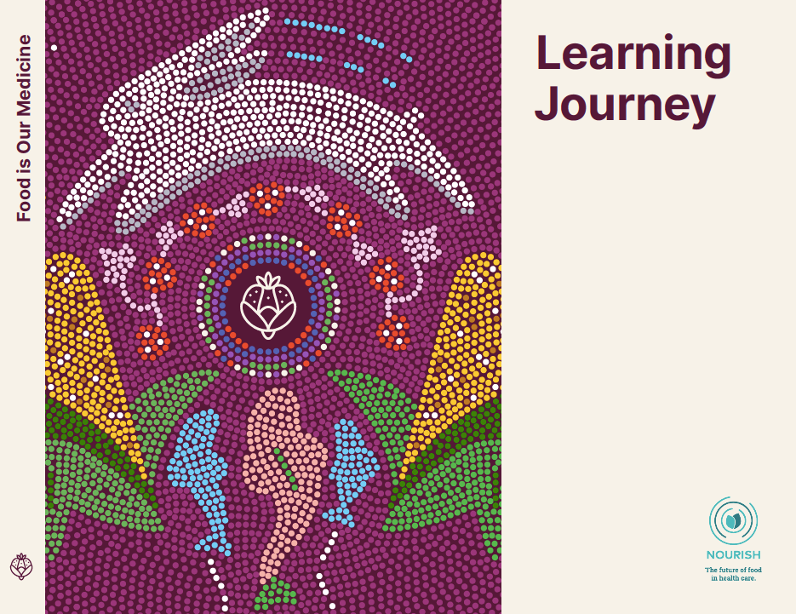
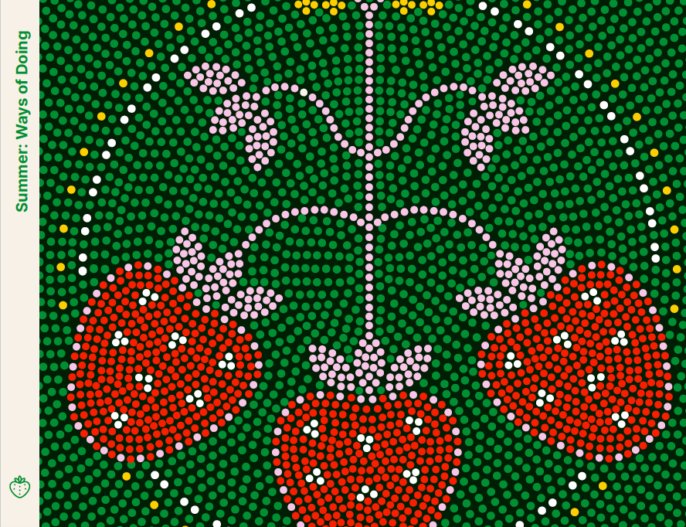
Food is Our Medicine Learning Journey
5 learning modules, based on the seasons to guide you, Intro, Fall, Winter, Spring & Summer
You can also download each PDF module on our website
Notes:
The Welcome Guide shares information about the Learning Journey, webinars & digital library.
This Introduction will give you step-by-step instructions.
Fall: Seeing the Path (4 teachings)
Winter: Ways of Relating (4 teachings)
Spring: Coming to Know (4 teachings)
Summer: Ways of Doing (4 teachings)

Slide 10
Food is Our Medicine: Introduction

Slide 11
What to Expect
Core resources and key resources are the foundation of each teaching, and are often from sources outside of Nourish. They are intended to be read or watched in their entirety, though we sometimes draw your attention to only part of the resource (e.g., specific pages of a text or sections of a video).
Additional resources are optional and are listed at the end of each teaching, allowing you to dive deeper into some of the subject areas covered.
Journaling prompts are the questions you are encouraged to fill out for the online course.
Pause and reflect questions are not mandatory, and encourage you to slow down and think more before continuing.

Slide 12
Journaling prompts
Why did you decide to go on this Learning Journey?
What do you think you might gain by completing this Learning Journey?
What hopes and fears come up as you think about the learning (and unlearning) that might be ahead?
By when do you commit to completing the four seasons of this Learning Journey?
Have you invited any colleagues to accompany you with a shared goal for completion?

Slide 13
The journey continues.

Slide 14
Food is Our Medicine: Food is Culture
Welcome to Fall.

Slide 15
Teaching 1: Embracing multiple perspectives
Journaling prompts
How do the spaces you move through (your community, your workplace, your home) shape, change, or reinforce the lens you see through?
What lens(es) does your workplace privilege or reward you for using?
In the video, Elder Albert Marshall asks how we can weave back and forth between these two ways of knowing. Are you ready and willing to “put on another [or different] lens”?
What do you stand to lose by trying on a different lens? What emotions, thoughts, or sensations come up?
What do you think you might gain from seeing through a different lens?

Slide 16
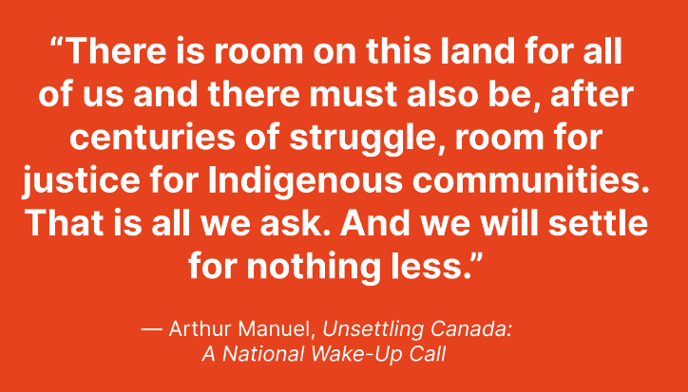
Teaching 2: Situating yourself and the work
Journaling prompts
What traditional territory do you live and
work on? How do you relate to this land?
What questions do you have about the
Indigenous ways of doing and culture from
your community? Try to come up with 2–3
specific questions that you can hold through this learning journey.

Slide 17
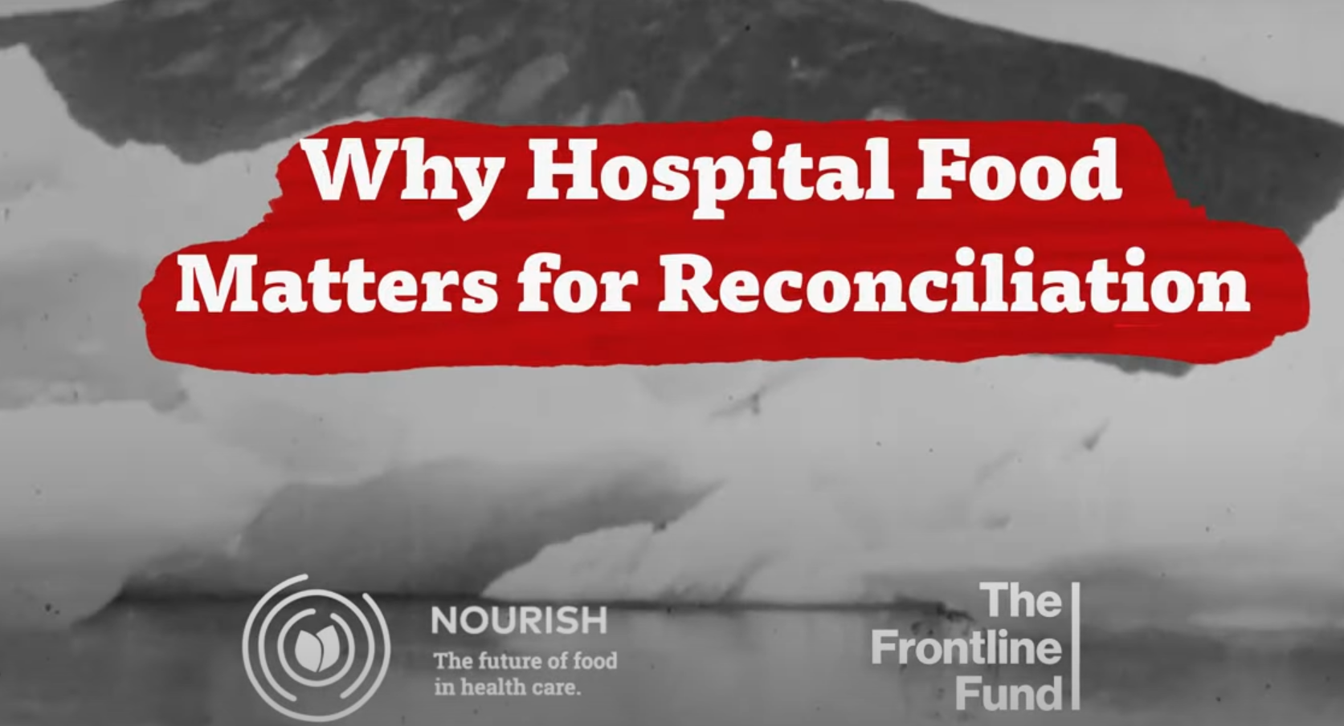
Teaching 3: Understanding systemic racism in health care
Journaling prompts
What emotions, feelings, thoughts, or questions come up as you reflect on the stories of Joyce Echaquan and Brian Sinclair, and the stories shared in the In Plain Sight report?
Have you witnessed systemic racism in your workplace? How does it show up? What assumptions or biases might be behind it?

Slide 18
Teaching 4: Examples of colonial impacts on food
Journaling prompts
How do the histories of Canada described in these resources mesh with your worldview of Canada? What strikes you about these pieces of Canada’s history? What, if anything, had you learned about them before?
How might Canada’s colonial history influence the present-day relationships of patients, residents, and communities with food?

Slide 19
The journey continues.

Slide 20
Food is Our Medicine: Food is Relationships
Welcome to Winter.

Slide 21
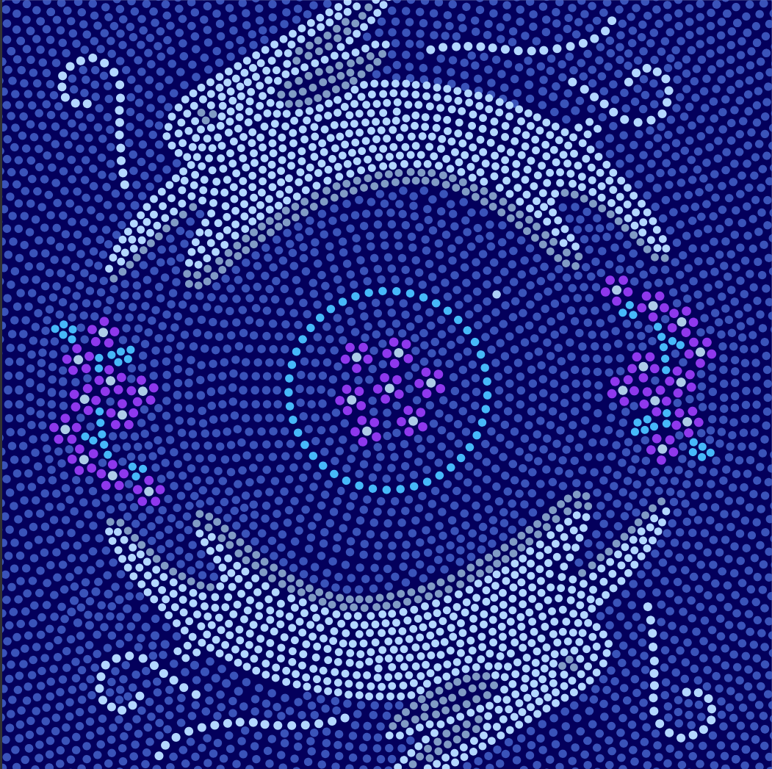
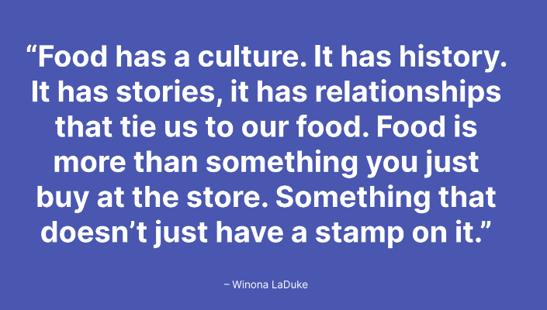
Teaching 5: Indigenous foodways are relational
Journaling prompts
How do these perspectives of food—as
relatives and as gifts—compare with your
own perspectives of food?
In what ways is salmon more than food to the members of the Xat’sull Nation? What teachings does it provide?
What would the food served in your local
hospital say if it could speak? What stories would it share from its journey to a patient’s plate?

Slide 22
Teaching 6: Exploring the Social Determinants of Health
Journaling prompts
In your own words, what is the difference between “race” and “racism” as a determinant of health?
What social determinants of health influence your personal wellbeing?
What theories have you heard for increased rates of chronic disease among Indigenous communities? What do you think about these theories now? What questions do you have?

Slide 23
Teaching 7: The Status of Truth and Reconciliation in Health Care
Journaling prompts
The TRC Calls to Action were released in 2015. What have you heard or read about the work of the Truth and Reconciliation Commission?
What are your thoughts on the health-related Calls to Action (18–24)?
What changes (if any) have you seen in your workplace since the TRC report was published in 2015?
What next steps could you personally take to advance the Calls to Action in your professional life and/or your personal life? We invite you to use the Back Pocket Reconciliation Action Plan to actively make reconciliation part of your life.

Slide 24
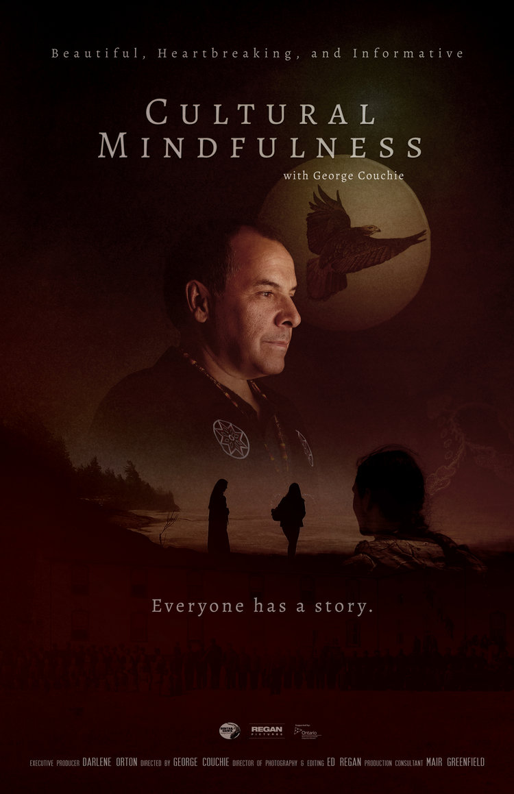
Teaching 8: Cultivating cultural mindfulness
Journaling prompts
As a health care professional or from your personal experience, which of these values and principles resonate with you? Which, if any, surprise you?
How do the values and principles in your practice or organization compare to these?
How might you cultivate cultural mindfulness in your work or everyday practice?

Slide 25
The journey continues.

Slide 26
Food is Our Medicine: Food is Healing
Welcome to Spring.

Slide 27
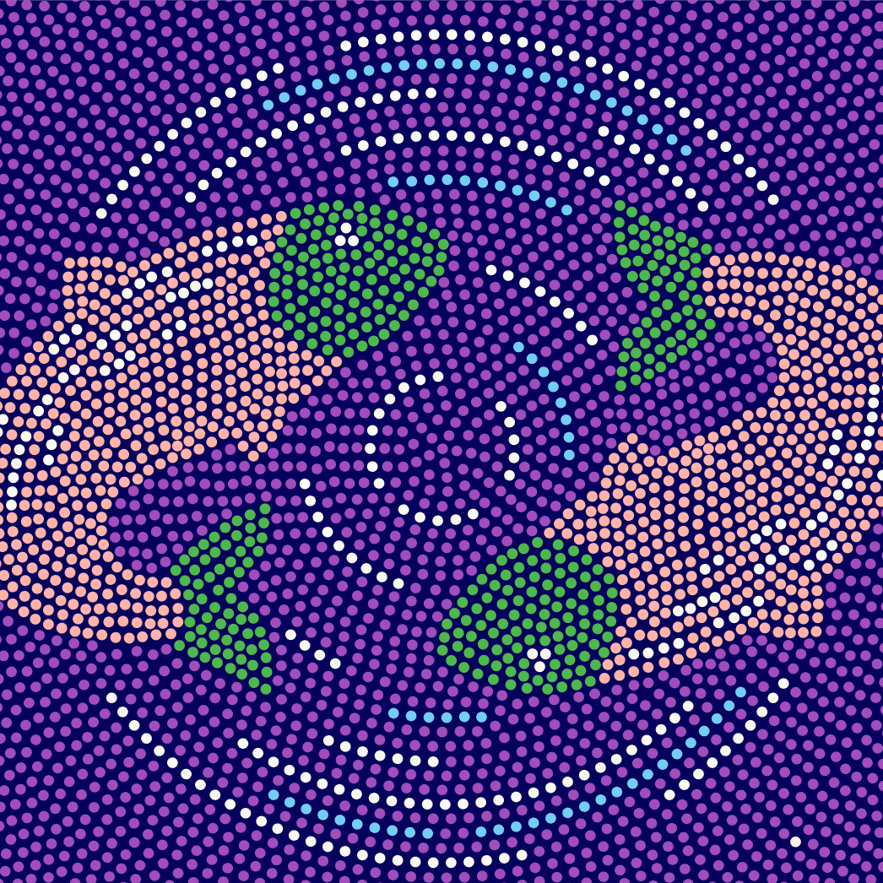
Teaching 9: What is a “healthy diet”?
Journaling prompts
Throughout your life, what messages have you heard about a “healthy diet”? Whose perspective(s) are these messages from? How do they compare to the perspectives outlined in the article from the University of Winnipeg?
While it may be difficult for Indigenous communities to return to a diet and lifestyle that includes only local Indigenous foods, what opportunities do you see to leverage Indigenous foods and perspectives for better overall health of Indigenous communities and families?

Slide 28
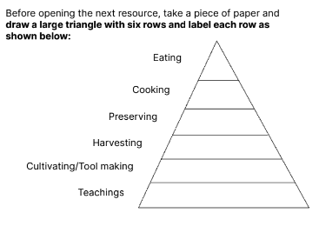
Teaching 10: Indigenous foodways – more than the food itself
Journaling prompts
What did you learn about the connection between the mind, body, spirit, and emotions?
How would you describe Indigenous food systems to someone who is not familiar with what you have learned so far on this learning journey?
What does “food is medicine” mean to you now?

Slide 29
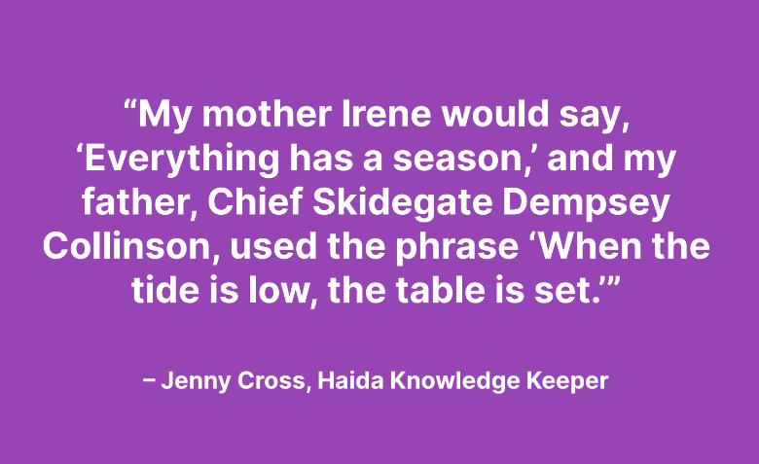
Teaching 11: Celebrating diverse Indigenous foodways
Journaling prompts
This teaching has shared a few specific foods and foodways from across Turtle Island. Are any of these traditional to the region where you live and work?
Think about your own culture, family, and home. What foods are traditional to you? What stories are connected to these foods and the way that you obtain, prepare, and share them?

Slide 30
Teaching 12: Foodways and COVID-19
Journaling prompts
After reviewing the article, what solution to support food access issues did the government implement that undermined Indigenous communities in addressing food insecurity during the pandemic?
How did COVID-19 make food insecurity worse?
What forms of Indigenous foodways strengthened food security?

Slide 31
The journey continues.

Slide 32
Food is Our Medicine: Food is a Pathway
Welcome to Summer.

Slide 33
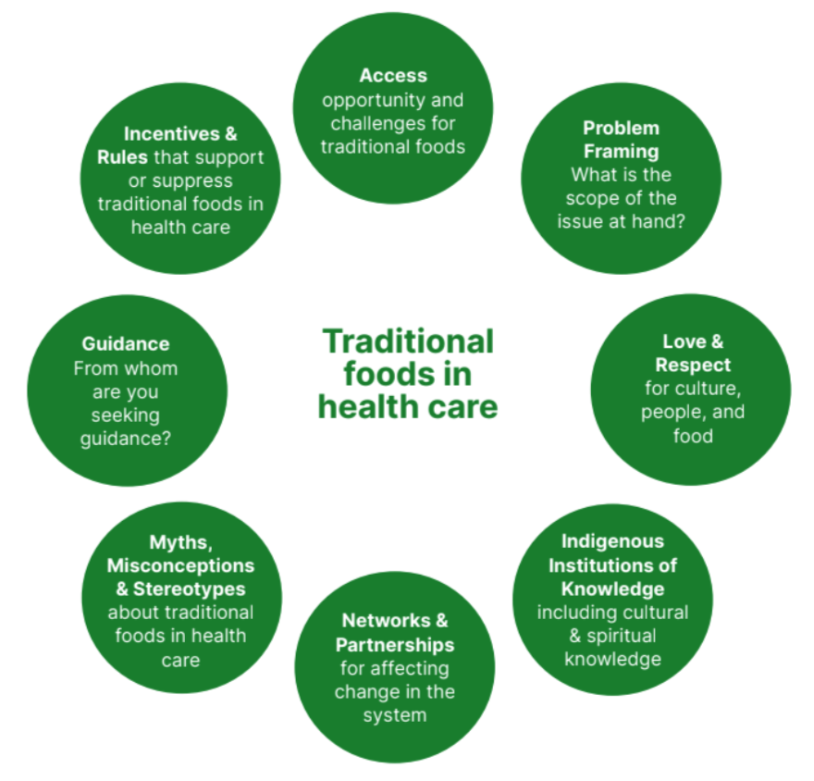
Teaching 13: Barriers to serving Indigenous foods in health care settings
Journaling prompts
Have you experienced any of these barriers to serving traditional foods in health care settings? If so, how have you overcome them or tried to overcome them? What solutions, innovations, or compromises have you come up with?
What has helped or hindered the process of serving traditional foods where you work?

Slide 34
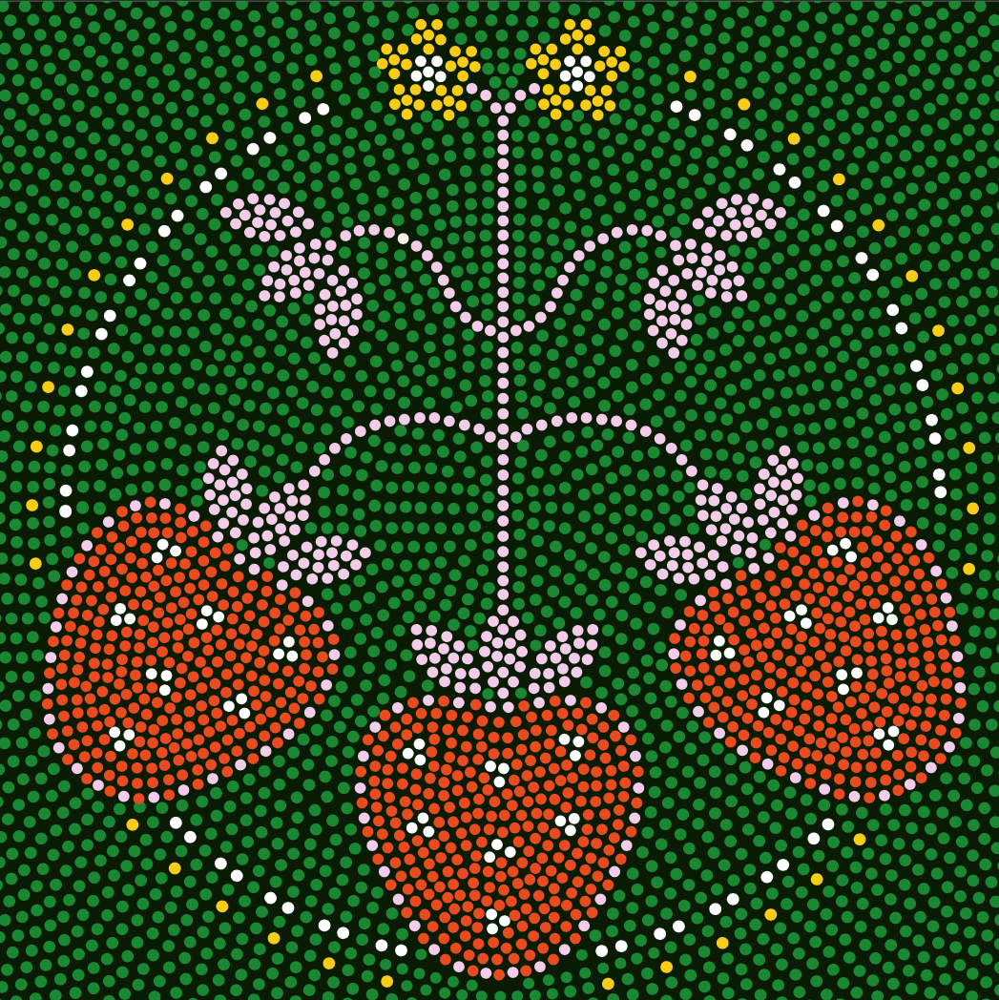
Teaching 14: Existing traditional food programs
Teaching 14: Existing traditional food programs
Journaling prompts
How many key stakeholders, working in different parts of the system, came together to support the Yukon Hospitals program?
Consider the relationships with key stakeholders in your setting and facility/organization. Which relationships are strong? Which do you need to strengthen? Which do you need to start building?
What questions do you have for stakeholders involved in any of the traditional food programs shared in this teaching?
Why do you think traditional foods are not available to all patients accessing services? What are some reasons for not making them available to all patients?

Slide 35
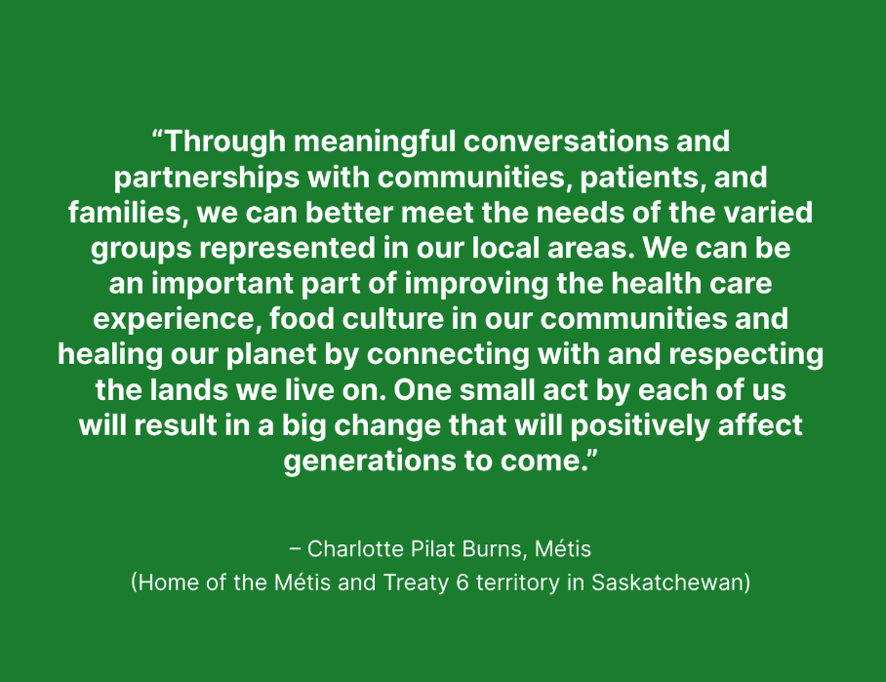
Teaching 15: Guidebooks, policies, and
administrative tools
Journaling prompts
In thinking about these programs and the different approaches they take, what ideas come up for you for ways to start (or continue) this work in your context?
What lessons can you apply in your work setting? Who and what can support you?

Slide 36
Teaching 16: The path forward
Journaling prompts
How do you relate to these ideas about what “the work” is?
How has your perception of “the work” grown or changed over the course of this Learning Journey?
The Nourish TFP team mapped out the following key themes related to traditional foods in health care settings. Write the steps you could take in any or all of these areas:
Love and respect
Guidance
Myths and stereotypes
Access
Networks and partnerships
Legislation
Sitting and spending time with Elders...
is the work.
Suspending judgement... is the work.
Listening... is the work.
Being on the land... is the work.
Eating and sharing food... is the work.
Learning from your process... is the work.
Sharing your learnings... is the work.
The knowledge you grow... is the work.
Building relationships.... is the work.

Slide 38
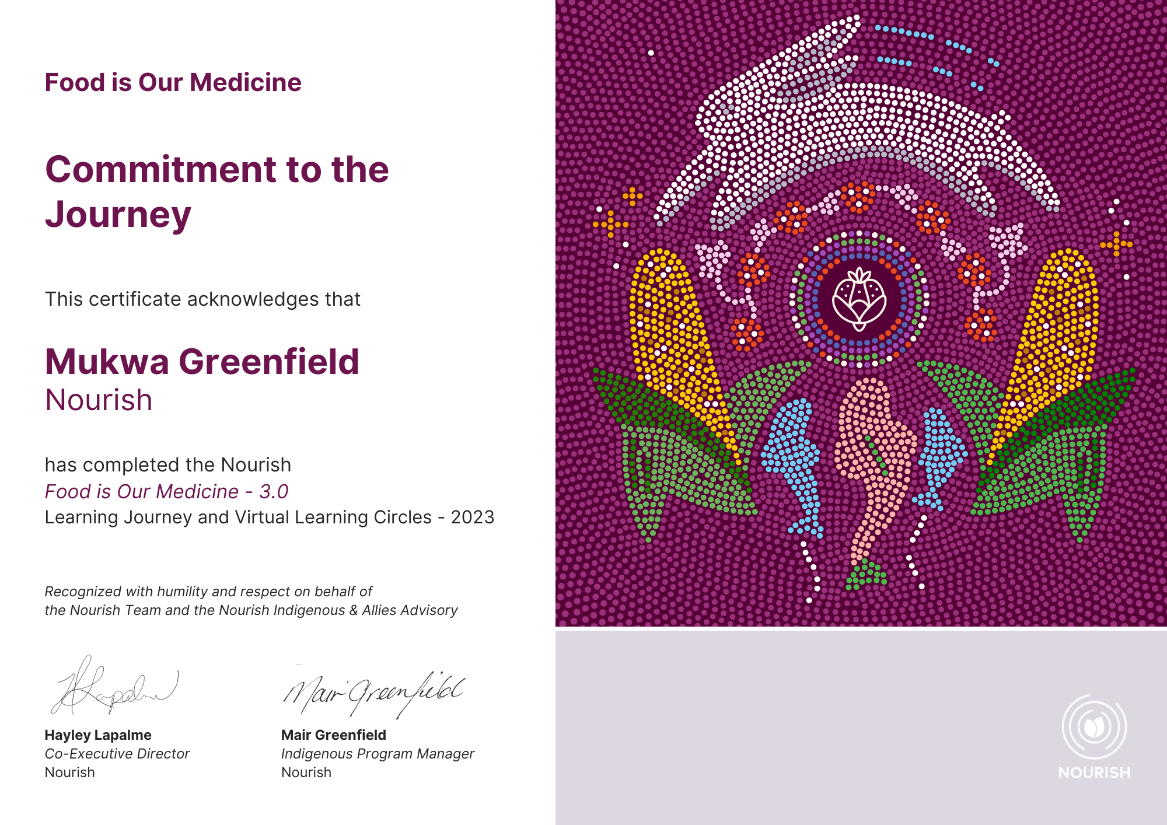
Be sure to upload all of your modules to the Nourish website. You will receive a certificate of recognition, along with a personalised certificate of completion.

Slide 40
Congratulations!
You have travelled through all four seasons of this Learning Journey with us. Let out a long exhale. How do you feel? Has anything changed for you? Who have you met or brought in along the way? Many silent teachers have been walking with you. Now it is up to you to decide your next steps: this is the responsibility of knowledge and one of the gifts of being alive.
Nya:wen, Ha’waa, Mahsi Cho, Miigwech… for journeying with us. We hope you have been inspired and we hope you have been able to share this journey with your peers.
Our respective paths will now diverge, but the journey continues and the learning never ends. Be humble, be curious, think about systems, see with “two eyes.” We look forward to hearing from you as you continue on your path. We will see you at the next Virtual Learning Circle!
The journey continues.

